Slide 1
INTRODUCTION TO MICROPROCESSOR
K.S.V.SAMBASIVARAO
HEAD,DEPARTMENT OF ELECTRONICS
P.B.S COLLEGE OF ARTS AND SCIENCE
VIJAYAWADA

Slide 2
MICROPROCESSOR SYSTEMS
It is a 16 bit micro processor contains 29,000 transistors and fabricated in HMOS technology
It increases the number of address pins from 16 to 20 and memory addressing capacity can be increases from 64KB to 2²⁰=1 MB
It has multi processing capabilities thus allowing to be use other processing elements such as 8087 numeric data processor.
The multiplex of address and data reduce the no. of pins needed but does not slow down the transfer of data 8086 require only.
One supply voltage +5v and clock frequency upto5MHZ.

Slide 3
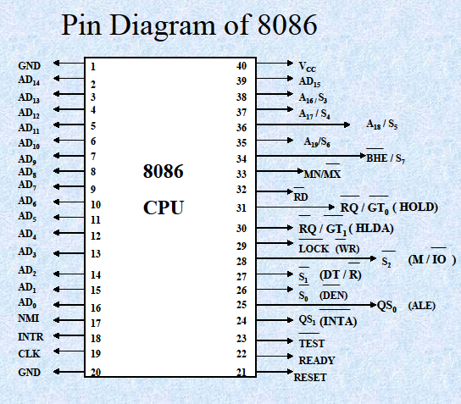
PIN DIAGRAM

Slide 4
It has two version 8086 to which permit clock frequency up to 8MHZ,8086-1 up to 10MHZ
It has 40 pins and two ground pins 1&20
ALE: It is used to generate +ve going pulse for every time, the microprocessor begins an operation.
READ:
This is a read control signal (active low),this signal indicated input/output or memory device is to be read and data are available.
WRITE :
This is write control signal(active low),this signal indicated on data bus are to written in selected memory (or) input/output location.
INPUTOUTPUT/MEMORY:
This is status signal used to different input output/memory. When signal is high it indicates input/output operation. When signal is low it indicates memory operation.

Slide 5
S₁S₀: These are status signals in similar to input output/memory can be identified by various operations, that are rarely used in small systems.
Trap: It is a non-maskable interrupt & has highest priority, it is level and edge sensitive meaning that input should go high & stay high to be acknowledge ,it can be enable & not disable. Trap is generally used for critical events as power failure & emergency shutoff.
INTR(INPUT):It is used as general purpose interrupts similar to INT signal.
INTRA (OUTPUT):
These vectors interrupts and transfers the programme counter to specific memory location. They have higher priority then interrupt.

Slide 6
HOLD:
This signal indicates that a peripheral such as DMA controller is requesting the use of address and data buses.
HLDA:
The signal is used for acknowledgement the hold request.
READY:
The signal is used to delay microprocessor read & write cycles with a slow responding peripherals ,ready to send or accept data. if signal is low, the microprocessor wait per an integral no. of clock pulses, until it goes high.
RESET IN:
When the signal on this pin go slow, the program me counter is set to zero. Bytes are pre started and microprocessor is reset.
RESETOUT:
The signal indicates that the microprocessor is being reset and it can reset other device.

Slide 7
ARCHITECTURE
In this the instruction register is 6 byte queue
The control and working registers are divided onto 3group’s according to their functions .
The data group which is essentially used for arithmetic registers, the pointer group include base and index registers & also contain sp & pc .
The segment group consists of four types i.e CS,DS,ES,SS.
In data group consists of AX, BX, DX registers. It is used to store operand & result.
AX is divided into 2 types i.e AH &AL
AH is high order byte and AL is lower order byte
For converting 8080 software in to 8086 software. The following corresponding can be drawn:
AH—A
BH---H

Slide 8
BX is used for BASE REGISTER address calculation.
CX is used for implied counter for certain instructions.
DX is used for input/output address during input/output operation
Base pointer is a base register for accessing as stack & may be used for other register and/or displacement that is a part of instruction.
The SI, DI registers are used for indexing although there may be used themselves and used with BX , BP. & IP can hold an operand.
To provide flexible base addressing and indexing, address may be form by adding together the combination of BX and BP contents, SI & DI register contents and displacement.
The result of such an address called Effective address.
To form an EA (effective address) the data address is determined by EA & appropriate cs,DS, ES, SS.
The IR is used to hold current instruction, while it is decoded and executed.
The PC is used to hold the address of next instruction.

Slide 9
Effective address has 16 bits, the extra 4 bits can be obtained by adding to the content of segment register.
If result is cs=123A,IP=341B,then the next instruction can be fetched as
341B--->EA
123A0 --->beginning segment address
157BB->physical address of instruction
E.A 16-BIT
+ 4BITS
S.A 16 BITS
Physical Address<- 20-BITS

Slide 10
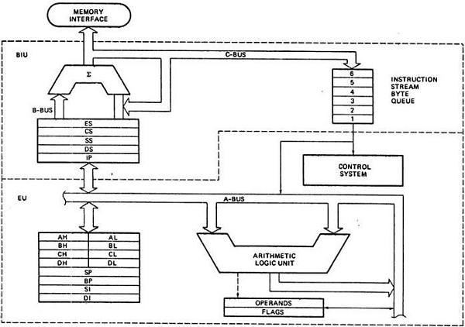

Slide 11
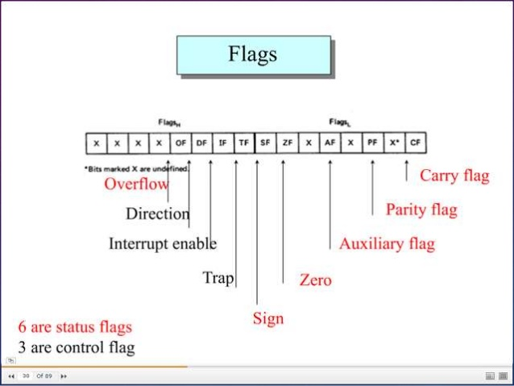

Slide 12
SF (SING FLAG):
It is an equal to MSB of result. Since 2’s compliment is –ve number have 1 is MSB and non –ve number this bit is zero.
This flag indicates whether the previous result is –ve or non –ve.
ZF (ZERO FLAG):
If said to 1,result is zero and zero if result is non-zero.
PF (PARITY FLAG):
If said to 1,the lower order 8bit result contain even number of 1’s otherwise is cleared.
OF (OVER FLOW FLAG):
If it set when result is out of range.
For addition flag is said when there is carry into
MSB or non carry into MSB vice versa.
For subtraction it is said when MSB needs a barrow and there is no barrow from MSB or vice versa.
.

Slide 13
DF (DIRECTION FLAG):
It is for string manipulation, if clear the string processed from its beginning with 1st element having lowest address otherwise the string is processed from high address to low address
IF (INTERUPT ENABLE FLAG):
If it is set for certain type of internal interrupt can be recognized by c.p.u otherwise interrupt ignored.
TF (TRAPFLAG):
If it is set the trap is executed after each instruction.
CF (CARRYFLAG):
An addition causes this flag to be said carry of MSB.
A subtraction causes to be said if barrow is needed otherwise instruction effects the flag.

Slide 14
THANK YOU

